Slide 1







MAGIST
THE RIGHT PARTNER?

Slide 2

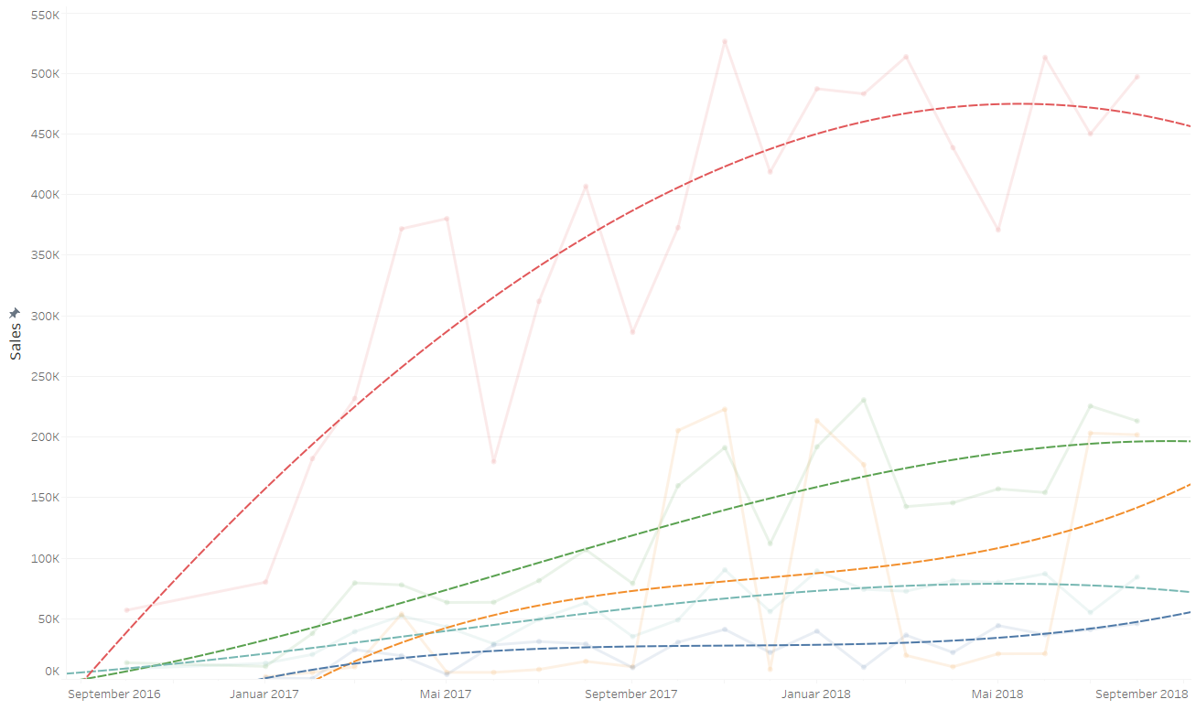
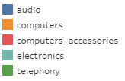
MAGIST SALES THROUGH TIME
5 TECH PRODUCT CATEGORIES FROM 74 IN MAGIST PORTFOLIO ARE RELEVANT FOR ENIAC AND REPRESENT THE 12 % OF TOTAL SALES.
MAGIST SALES DOESN'T SHOW SIGNIFICANT GROWTH IN TECH PRODUCTS SINCE Q1 2018.
Page / 2

Slide 3
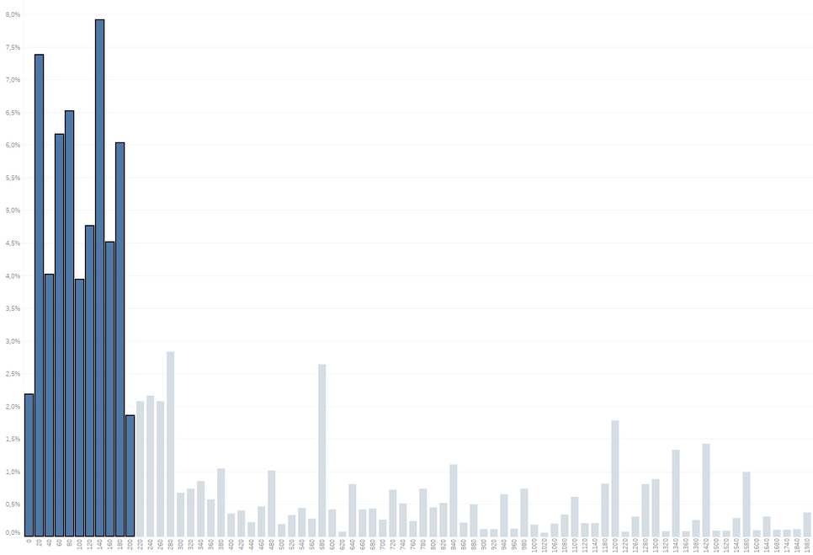
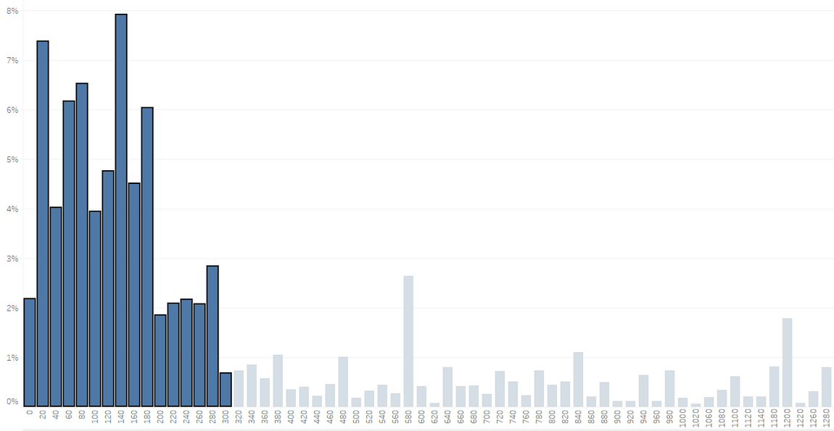

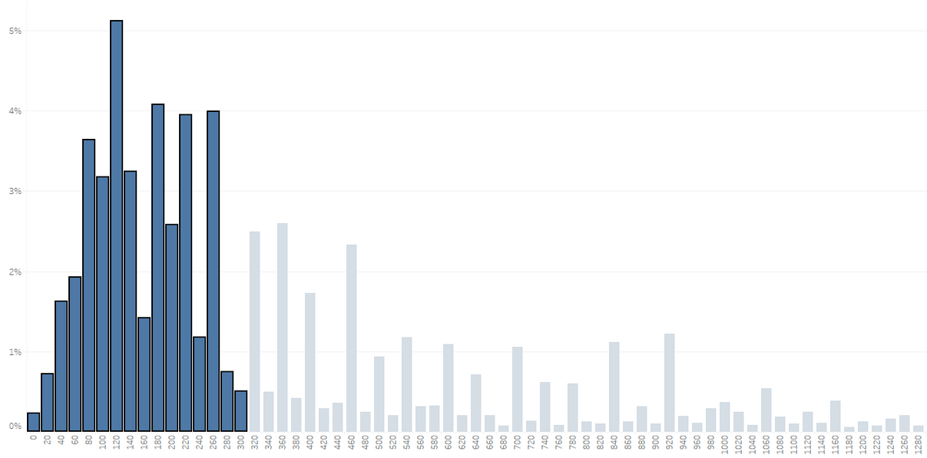
PRODUCT PRICE DISTRIBUTION ON MAGIST CATEGORIES OF INTEREST
PRICE DISTRIBUTION
OUR PRICE DISTRIBUITION FINDS ITSELF IN A HIGHER RANGE THAN MAGIST'S BUT SHOWS SIMILARITIES
65% OF MAGIST SALES IN TECH CATEGORIES ARE PRODUCTS PRICED FOR LESS THAN 300
38% OF OUR PRODUCTS FIT IN THIS RANGE
PRICE DISTRIBUTION ON ENIACS PRODUCTS
Page / 3

Slide 4

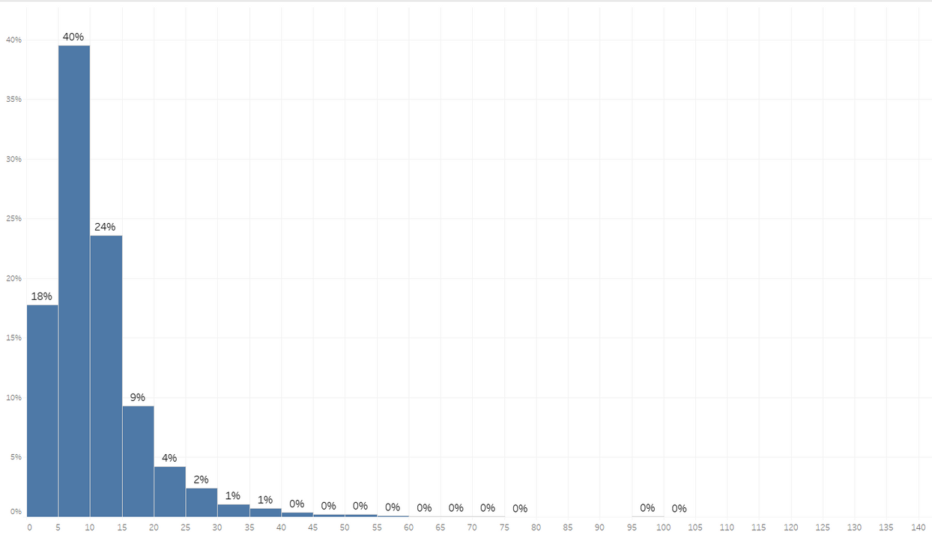
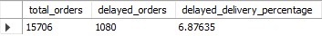
DISTRIBUITION OF ORDERS THROUGH DELIVERY TIME
ARE ORDERS BEING DELIVER?
90% OF THE ORDERS ARE DELIVERED IN LESS THAN 20 DAYS.
SHARE OF DELAYED ORDERS IS 7%.
MAGIST HAS A RELIABLE DELIVERY PROCESS THROUGH THE PUBLIC POST OFFICE
Page / 4

Slide 5

OVERVIEW AND RECOMENDATIONS
MAGIST IS A SUITABLE PARTNER TO ENTER BRASIL MARKET.
KEY ARGUMENTS:
MAGIST DEAL WITH PUBLIC POST OFFICE HAS RESULT IN A RELIABLE DELIVERY SYSTEM.
ENIAC PRODUCTS FIT TO PRICE RANGE WITH MOST SALES AND HAVE A POTENTIAL TO ENTER MID AND HIGH PRICE SEGMENTS.
FOLLOWING RECOMENDATIONS:
INVESTIGATE ENIAC PRICE DISTRIBUTION BY CATEGORIES
REQUEST MORE ACCURATE DATA
EXPLORE TECH PRODUCTS MARKET IN BRASIL
INVESTIGATE IMPORT TAX POLICY
COMPARE MAGIST DELIVERY DATA AGAINST ENIAC'S STANDARDS
Page / 5

Slide 6


Page / 6

Slide 7


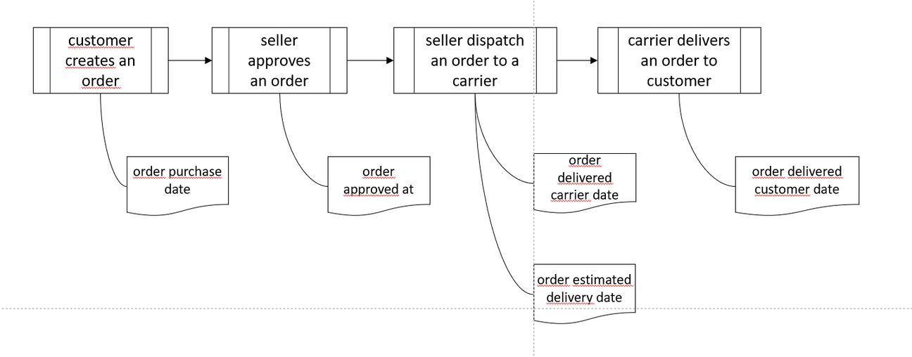
BACKLOG AND ASSUMPTIONS
OUR UNDERSTANDING OF DELIVERY PROCESS
ID GIVEN TO EVERY ORDER PLACE BY USERS
CUSTOMERS CREAT AN ORDER
SELLERS APPROVES AN ORDER
ID GIVEN TO EVERY USER
ORDER DELIVERED TO CARRIER
EDT PROVIDED FROM CARRIER
ORDER DELIVERED TO CUSTOMER
Page / 7

Slide 8
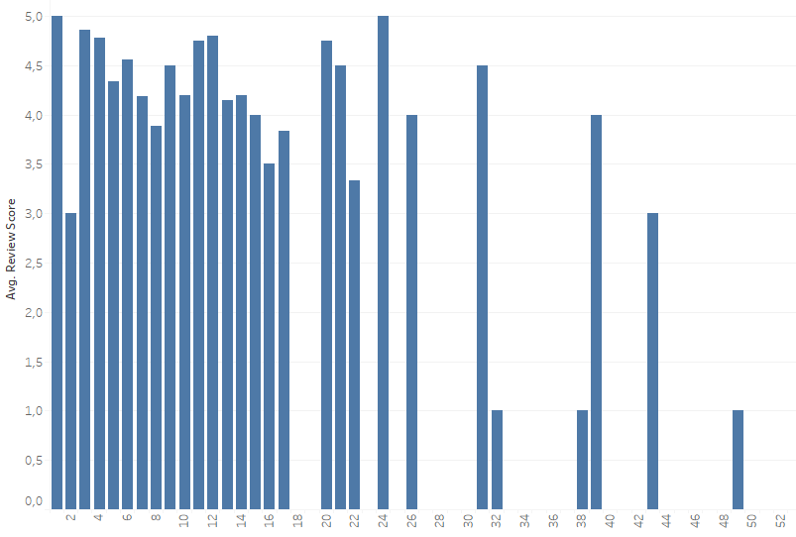
DELIVERY VS CUSTOMER REVIEW SCORE

Slide 9
BACKLOG AND ASSUMPTIONS

